Slide 1
CSCE 623 In Class Day 2 Part 2
Synchronous session

Slide 2
Agenda for Day 02 Part 2
Linear Algebra Structures and Operations Review
Think/Pair/Share Exercise
Review key concepts: Data, Model, Parametric methods
Questions & Break
Coding Practice: making structures in numpy, basic operations
Preview of Post-Class Learning Activity: Simple linear regression
Questions & Dismissal

Slide 3
Activity: Linear Algebra structures and Operations Review (Worksheet)
Instructor will provide directions on completing the worksheet:
Work on Questions 1, 2, 3 individually (5 min)
Instructor will create breakout groups (10 min)
Review questions 1-3 with peers to see if you got the right answers
Work on Q4 as a team
After Return from breakout group – be prepared to answer instructor questions from Q1-4

Slide 4
ML Key concepts
Defining a ML Task
Data
Model
Parametric Model Example: Linear Regression

Slide 5
Defining the (supervised) ML Task
Given a dataset with features X and target labels y
Build a model which can estimate y from X

Slide 6
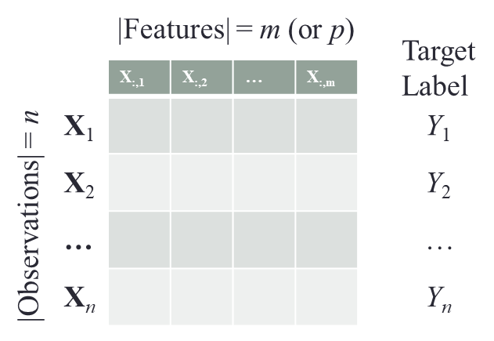
Data

Slide 7
Model
ε_{i}
f

Slide 8
Parametric Methods Example: Linear Regression
Reduces the problem of estimating f to estimating a set of parameters.
Two-step model based approach
STEP 1:
Make some assumption about the functional form of f, i.e. come up with a model. For example, a linear model:

Slide 9
Parametric Methods (cont.)
STEP 2:
Use the training data to fit the model i.e. estimate f or equivalently the unknown parameters such as β₀, β₁, β₂,…, β_{p}.
Individual prediction error terms can be computed:
One common approach for estimating the parameters in a linear model is ordinary least squares (OLS) – which minimizes the square of the sum of the error terms.
Has limitations due to computational tractability of inverting a matrix
There are other approaches
META: Why do you think we would want to use OLS in a linear model? (hint – what does squaring the error terms do to their prominence?)

Slide 10
Questions?

